Slide 1
HELICOPTER SAFETY & LANDING ZONE TRAINING
05/2017

Slide 2
Overview
Criteria for Flight
Helicopter Safety
Establishing a Landing Zone
Communicating with the Aircraft
Landing Zone Security
Hazmat

Slide 3
CRITERIA FOR FLIGHT

Slide 4
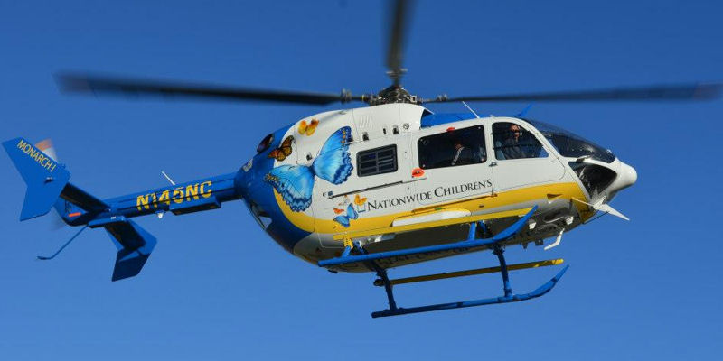
Considerations for Flight – Medical
Pediatric Respiratory Distress or Arrest
Cardiac:
  Age 50 or older
  History of cardiac disease
Stroke symptoms
Loss of Consciousness or Unresponsiveness

Slide 5
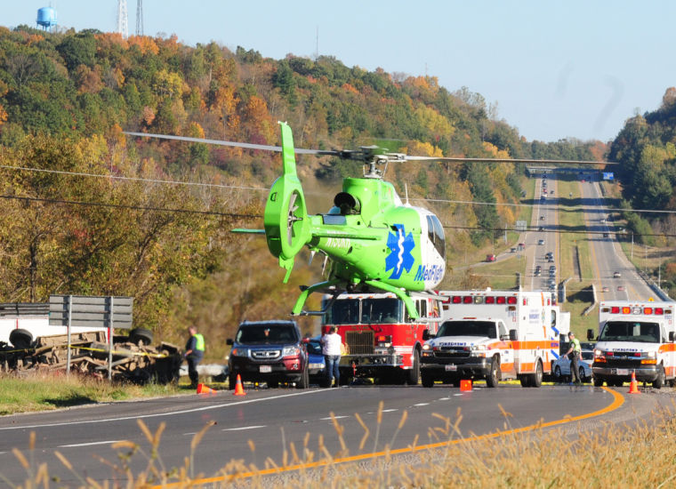
Considerations for Flight –
Mechanism of Injury
MVC with:
  Multiple Patients
  Reported Fatalities
  Entrapment
  Motorcycle Involvement
  Rollover/Ejection
  Train Involvement
Auto vs. Pedestrian
  Semi vs. Auto

Slide 6
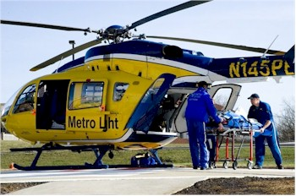
Considerations for Flight– Burns
Burns > 20% TBSA or >10% 3rd degree
Burns with respiratory involvement
Consider age (<5 or >65) and co-morbid conditions
Circumferential burns
Burns involving the genitalia, palms of the hands and/or
soles of the feet
Dispatch Discretion

Slide 7
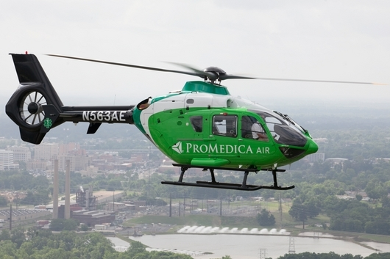
Considerations for Flight – Other
Death of another person in same accident
Trauma with pregnancy 3 months or greater
Traumatic arrest
Total or partial amputation of an extremity
Major lacerations with hemodynamic instability
Fall of significant distance

Slide 8
HELICOPTER SAFETY
Notes:
Incorporate 2 safety questions:
Are any other aircraft responding to this scene/location?
Have any other aircraft declined this flight for weather?

Slide 9
When Calling for an Aircraft
The following two safety questions should always be asked whenever requesting a helicopter from any flight service:
Are any other aircraft responding to this scene/location?
Have any other aircraft declined this flight for weather?

Slide 10
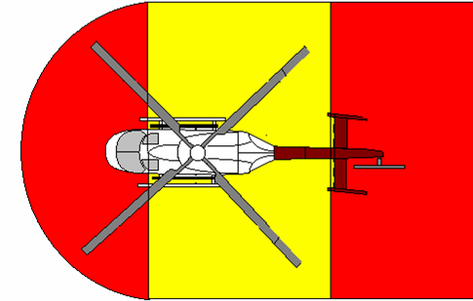
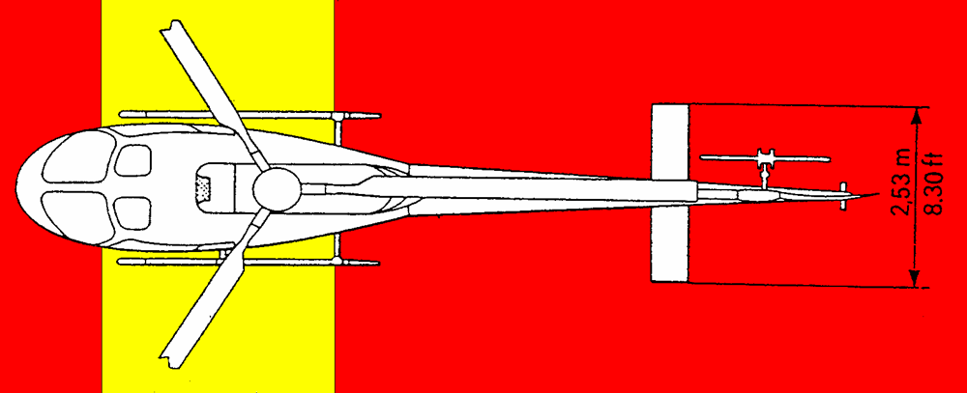
Danger Areas Around Helicopters
Danger Areas On
ANY HELICOPTER
Main rotor
Tail rotor
Exhaust
Pitot tube

Slide 11
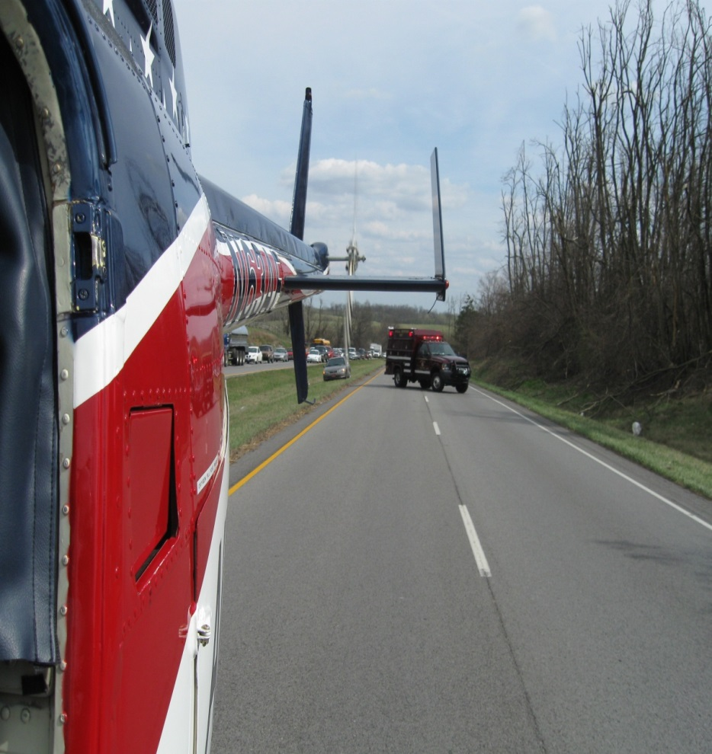
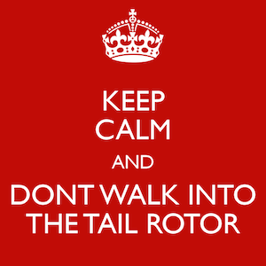
Tail Rotor
2500+ RPM
Nearly invisible
Stay well clear!
Numerous injuries and fatalities due to momentary loss of attention!

Slide 12
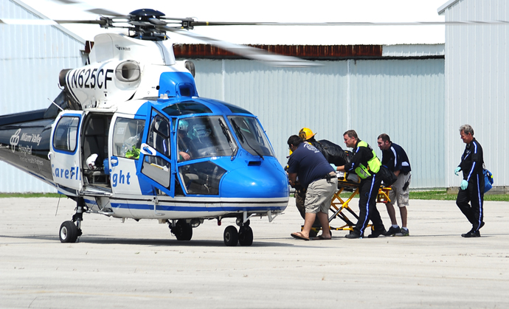
Main Rotor
Main rotor blades can flap as low as 5 feet above the ground on a flat surface with some helicopters and can be even lower due to uneven terrain.

Slide 13
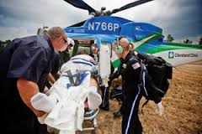
Main Rotor (Continued)
Slow spinning rotor blades (during start-up & shut down) will flap lower than rotor blades spinning at full speed
Never approach the helicopter without making eye contact and receiving an ok from pilot
Absolutely never when the helicopter is starting up or winding down
Notes:
Add something about making eye contact.

Slide 14
Aircraft Emergency
If you are responding to an aircraft accident, keep the following in mind:
Stay clear of any moving main or tail rotor blades
Take direction from the pilot if possible
Place the fuel valve and oxygen switch in the off position, followed by the battery switch in the off position
Aircraft vertical switch panels – down will place the switch off. Horizontal panels (floor or overhead) – back will place the switch off.

Slide 15
Aircraft Emergency (continued)
During this outreach training, review the location of the switches mentioned and the location of the fuel cells, oxygen bottle and battery.
Different types of aircraft will have different configurations and should be reviewed with all air medical providers in your area.

Slide 16
ESTABLISHING A
LANDING ZONE

Slide 17
An air medical helicopter can serve you only if we arrive safely. Our SAFETY and the safety of the people on the ground depends on YOU, the professionals at the scene.
The ideas presented in this class are based on guidelines.
Your county SOP may be slightly different.
As long as the helicopter that serves your area is aware of your procedures, they are perfectly acceptable.

Slide 18
LZ Considerations
Size of the LZ
Surface
Slope
Obstacles
Loose Objects
  Anything that is light and could be blown away by downwash (Bounce houses, tents etc.)
Wind
Approach Path
Marking the LZ

Slide 19
Landing Zone Size – Day/Night
OACCT recommends establishing an LZ with a minimum size of 100’ X 100’ for day or night operations.
When determining the LZ size remember to look up and consider obstacles that are above the ground level (tree limbs, etc.).
Notes:
Change LZ sizes to 100X100 for day and night.

Slide 20
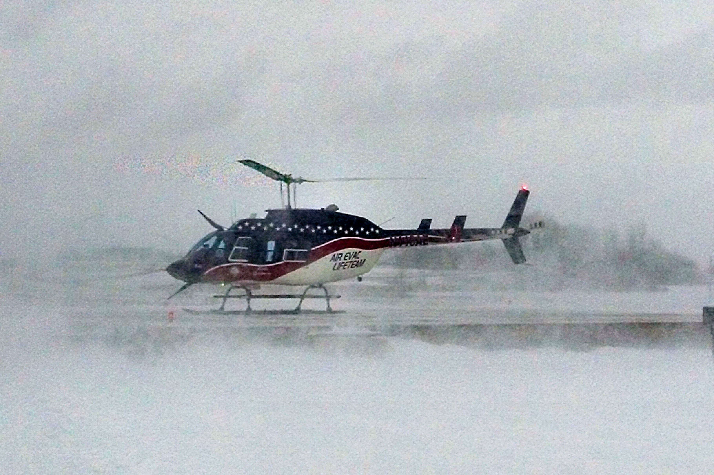
Problematic Landing Zone Surfaces
Dust/Dirt
Gravel
Mud
Snow/Ice
Fresh cut grass/Hay

Slide 21
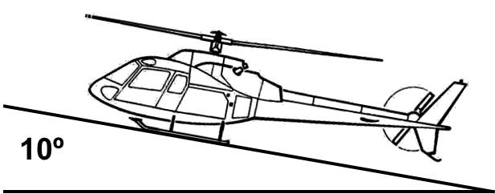
Landing Zone Slope
The landing area should be level (if possible)
The exact slope allowed varies slightly for
different types of helicopters
No more than 10 DEGREES

Slide 22
Landing Zone Obstacles
Wires
Drones
Loose Objects
  Anything that is light and could be blown away by downwash (Bounce houses, tents etc.)
Telephone poles/Antennas
Trees

Slide 23
Landing Zone Obstacles (Continued)
Fence Posts/Signs
Stumps
Bushes/shrubs
Tall grass (hidden obstacles)
Hidden holes & ditches
Rocks & logs

Slide 24
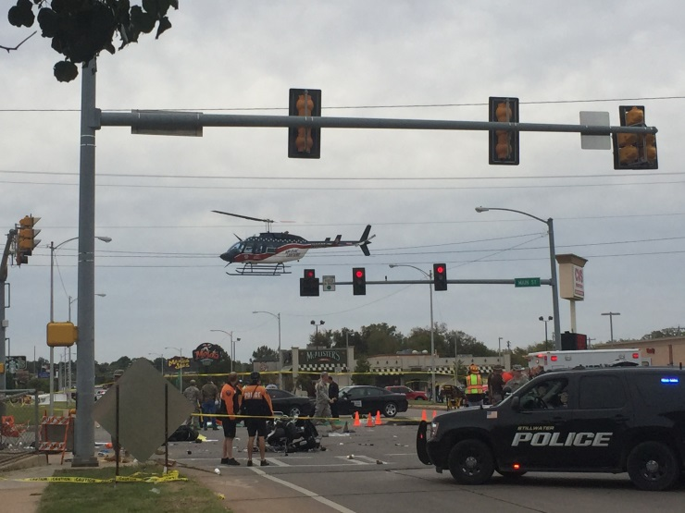
The #1 threat to a landing EMS helicopter is
WIRES!
Wires may be obvious from the ground,
but INVISIBLE to the helicopter crew (especially at night).

Slide 25
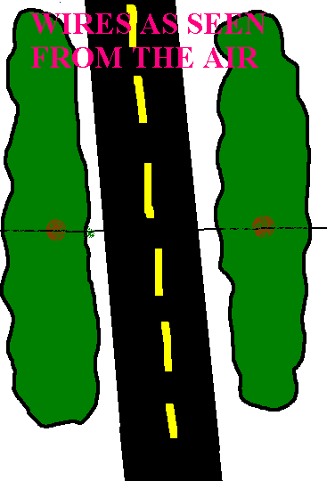
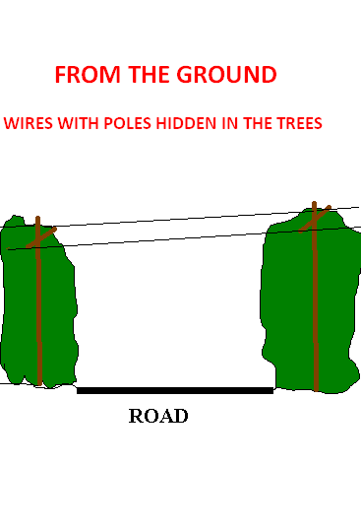
FROM THE AIR

Slide 26
Marking the LZ
This class will use guidelines as developed by NEMSPA and published in FAA advisory circular 135-14A
Day/Night procedures
You may need to be creative

Slide 27
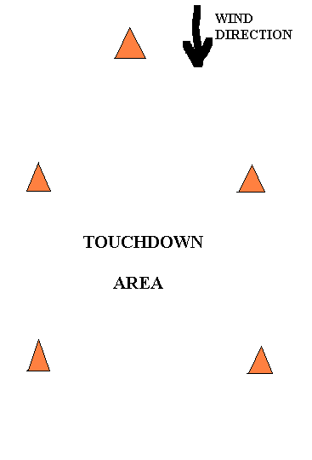
Day Recommendations for
Marking the LZ
Traffic cones (may blow over)
Use 5 cones – four corners
and one to mark wind direction
Do not use loose objects such as
air panels, sheets, fire coats

Slide 28
Night Recommendations for
Marking the LZ
Lights instead of cones
LZ light kits are available
Spotlights
Vehicle headlights

Slide 29
Spotlights, Floodlights & Road Flares
An excellent means of defining the LZ
Use caution to ensure all bright white lights are angled down so they will not affect the pilot’s night vision
Red flashers and strobes are an effective means of
identifying the LZ
Road Flares are commonly used, very effective, easily seen from the air
  CAUTION: Road flares are a source of ignition and can blow away in rotor wash
Other light sources can be used if available

Slide 30
Lighting Considerations
During NVG Operations
Use red or blue lighting to identify LZ, avoiding white lights and spotlights
Reduce lighting for helicopter approach/
landing
Bright lights in landing area will impair the pilot more than help once the LZ is identified
Chemical lights work well for NVGs
GEN 4 NVG’s are autogated and “throttle” in response to bright/blinking lights reducing resolution & clarity

Slide 31


NVG Throttling

Slide 32
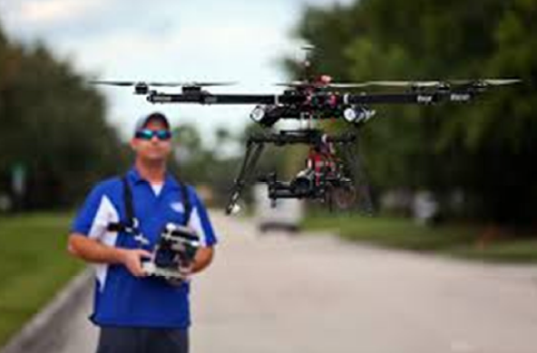
Drones

Slide 33
Drones – Four Key Points to Consider
ASSESS
In addition to assessing scene safety around the perimeter, a 3-dimensional approach should be taken, ensuring that the area above the scene is safe as well. A standard assessment includes a review of wires and other obstacles in and around an LZ, as well as drones.
COMMUNICATE
Do not assume that the pilot has a visual on the drone. Maintain open communications with the pilot via radio so that you can report drone sightings as soon as possible to maximize reaction time, even if the drone is stationary.

Slide 34
Drones – Four Key Points to Consider (Continued)
IDENTIFY
Identify the drone operator if possible and engage them. Inform them of the boundaries and the requirement to communicate their intent to operate a drone prior to doing so.
LAND
When in doubt, have the operator LAND THE DRONE. It is always better to err on the side of caution. No video footage is worth the potential risk of an avoidable incident.

Slide 35
Keys to Eliminating Obstacles
A thorough “3 dimensional” check of the landing area
  Look above and around the LZ to ensure it is clear for the helicopter
Obstructions should be marked or avoided
The least obvious obstruction may be the most dangerous
Ensure the pilot is aware of all potential obstacles
If there is ANY question, pick a new LZ

Slide 36
Remove and/or Secure all Loose Objects from the LZ
Trash/Debris
Equipment/Tools
Mailboxes
Vehicles/Vehicle Doors
Farm Animals/Pets
Loose Tarps
Open or unlatched Dumpsters

Slide 37
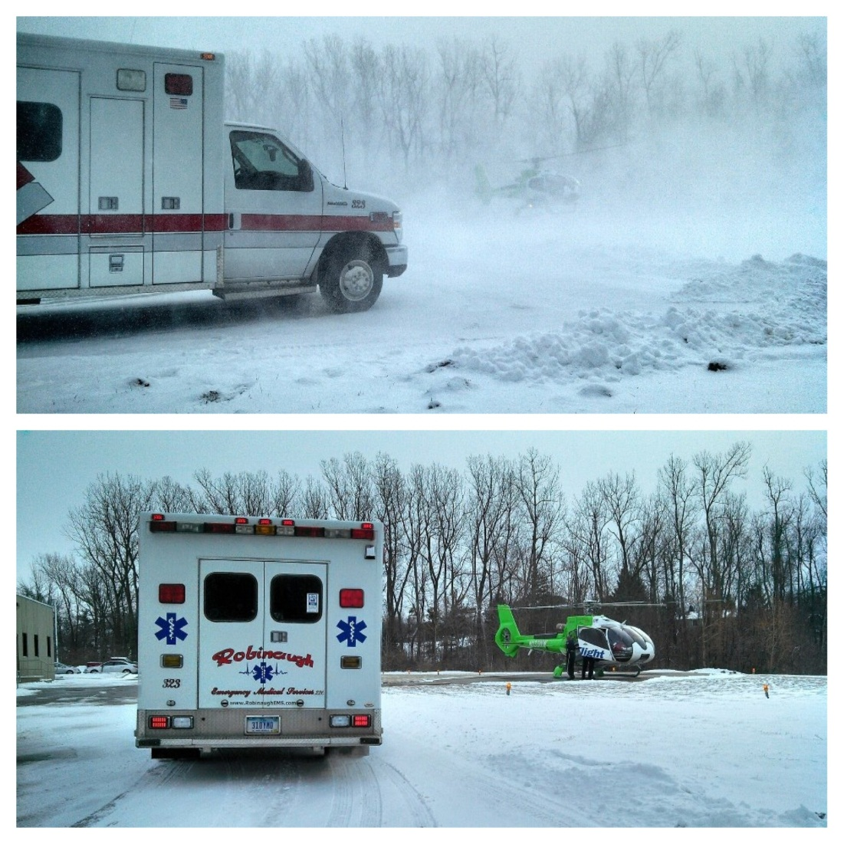
Rotor Wash
Rotor wash can be
very strong!
A fully loaded helicopter
can create GALE and
even HURRICANE force
winds in a small area

Slide 38
Wind Direction & Approach Path
Note the wind direction
Helicopters land and take off into the wind, when possible
Pilots must balance wind direction and approach path obstacles
Approach should be clear of all obstacles (wires, poles, antennas, etc.)
Into the wind is preferred!

Slide 39
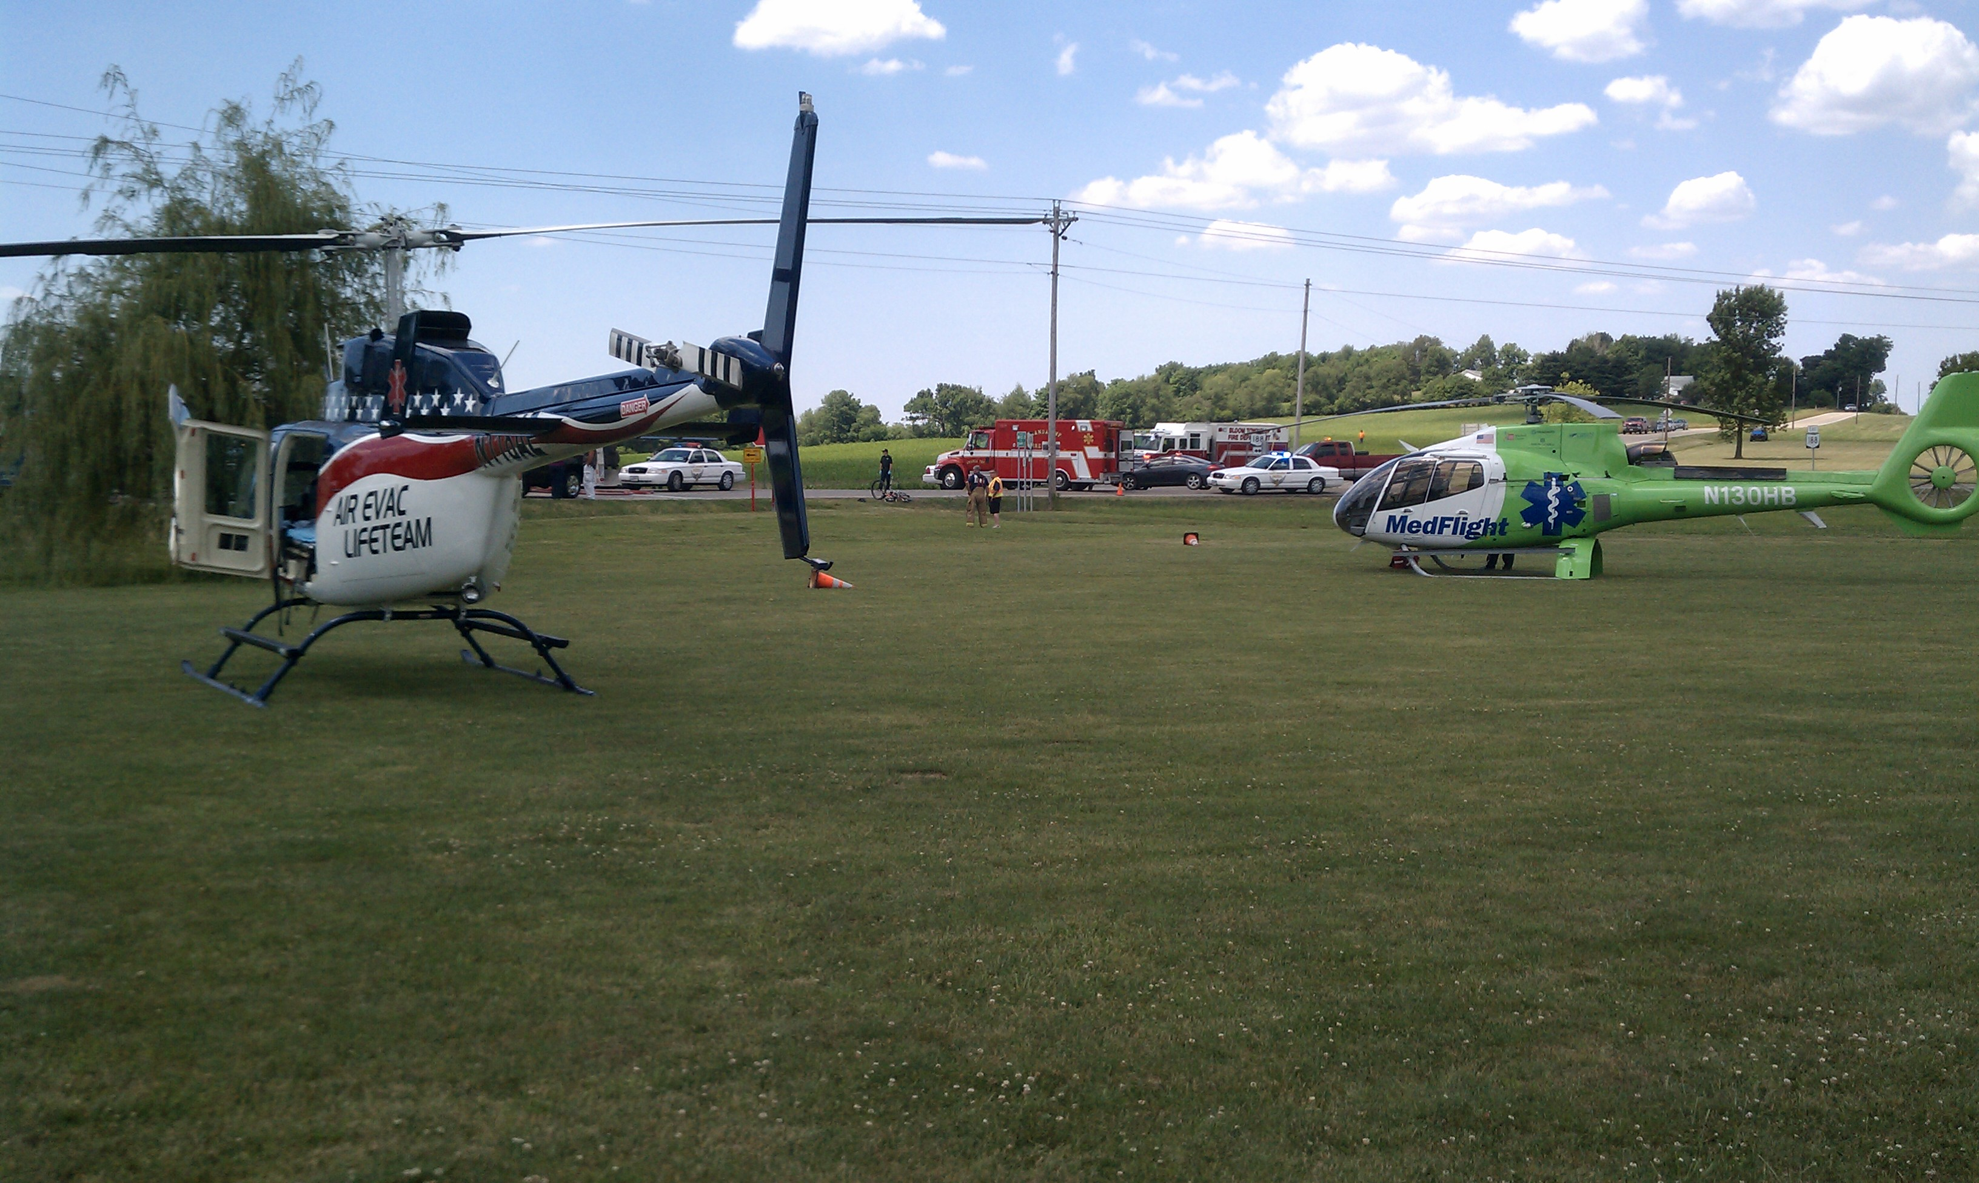
Multiple Aircraft

Slide 40
Multiple Aircraft Considerations
Inform ALL aircraft and agencies involved that there are multiple aircraft responding to the LZ.
Position LZ’s so that aircraft will not have to over-fly another parked aircraft on approach or departure.
Ensure adequate spacing between landing areas (50 feet minimum between landing areas).
Position LZ’s so that you NEVER have to walk behind one helicopter to get to another.
Be extra diligent controlling pedestrian/vehicle traffic in and around the LZ until all aircraft have departed.

Slide 41
COMMUNICATING WITH THE HELICOPTER

Slide 42
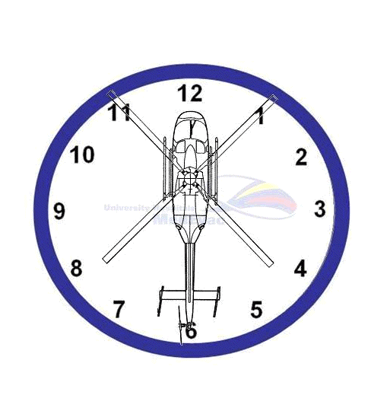
When directing the helicopter to your location use the Clock Code based on the “NOSE OF THE AIRCRAFT”
When directing flight crew to scene,
Directions need to be from the viewpoint of the pilot, not you.
The pilot is always at 12 O’Clock.
EXAMPLE: You are facing north. If the aircraft is flying past you, northbound and on your left side, then you are at their 3 O’Clock

Slide 43
Clear, concise directions are essential. Do not use code, abbreviations or hand signals.
“Land in front of the engine?”

Slide 44
LZ Brief Content
General description
Size
Topography (surface features)
Obstacles
Wind
LZ Markings
Location in relation to incident site
Any other pertinent information

Slide 45
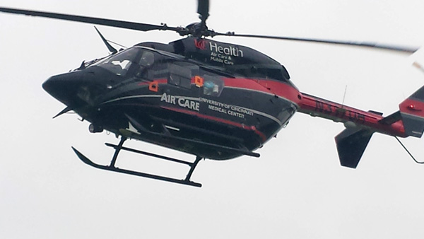
The Landing Zone Brief
Who gives the brief ?
What needs to be included ?
SAMPLE LZ BRIEFING:
  Ground EMS/Fire: “AirCare 3, you will be landing in an ELEMENTARY SCHOOL PARKING LOT located just WEST OF THE ACCIDENT SCENE. The LZ is a FLAT, PAVED SURFACE, 300 FT X 300 FT. There are POWER LINES, 75 FEET HIGH, along the EAST SIDE OF THE LZ. There is also a FLAGPOLE 100 FEET NORTH of the LZ. The zone will be marked with 4 AMBER LIGHTS. There is a STRONG WIND from the NORTHEAST.”

Slide 46
Communications – Radio Frequencies
The OACCT recommends using the following National Public Safety Planning Advisory Committee (NPSPAC) universal frequencies/talkgroups for LZ communications:
  a. 700/800 MHz radio: 8TAC92D or 8TAC94D
  b. VHF Radio: VFIRE21, Tx & Rx 154.2800, Tx CTCSS 156.7, No Rx CTCSS
  c. UHF Radio: UTAC41D, Tx & Rx 453.4625, Tx CTCSS 156.7, No Rx CTCSS

Slide 47
“ABORT”
If at anytime during the landing, you, as a first responder on the ground, see a hazard (wires, obstructions, towers, etc.) that the helicopter is getting close to, or ANY dangerous situation developing, please immediately state “ABORT” on the radio. The pilot will immediately abort the landing and climb to get to a safe altitude to assess the situation.
It is always better to abort and do a second approach than to allow an unsafe situation to develop into a possibly catastrophic situation. The minor delay is well worth the safety of everyone involved.

Slide 48
LANDING ZONE
SECURITY

Slide 49
LZ Security
Security must be maintained from the time the helicopter begins their approach to the LZ until after it has departed the LZ.
All emergency personnel, including the Aircraft Ground Guide, should clear the landing zone prior to the aircraft beginning short final.
If the helicopter cannot safely get into and out of the landing zone, then you have not helped your patient.

Slide 50
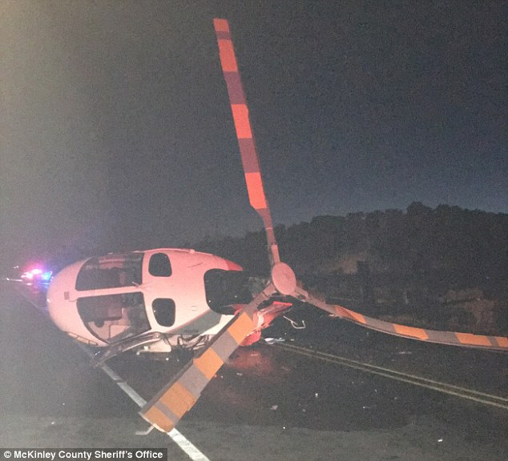
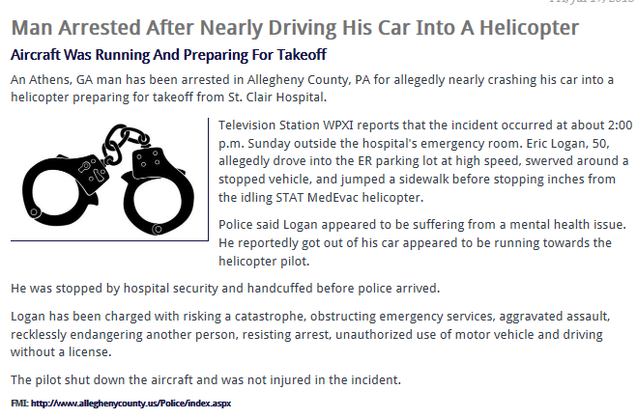
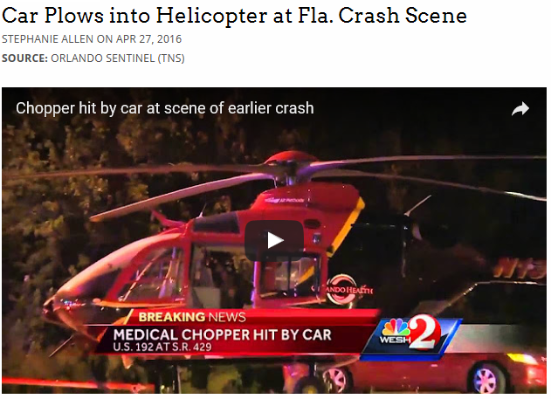
LZ Security
This emergency medical helicopter was badly damaged after a suspected drunk driver crashed into it after colliding with a fire truck outside Gallup in New Mexico

Slide 51
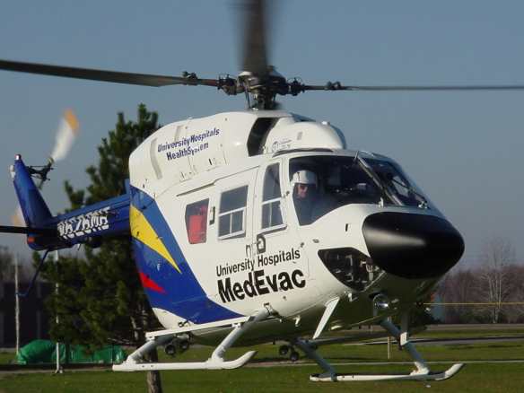
LZ Security (Continued)
If the helicopter is running while the medical personnel are in the ambulance packaging the patient, someone needs to ensure the LZ is kept clear of all pedestrian & vehicle traffic.
Keep public back 200 feet
Keep Fire/Rescue back 100 feet

Slide 52
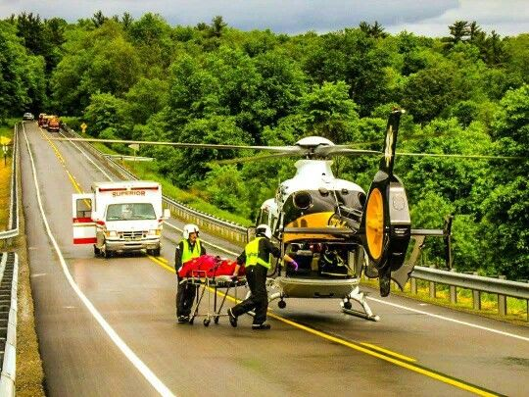
“HOT” Loading of the Helicopter
Will be at the Direction of the Flight Crew
Your assistance may be required and is appreciated
Flight crew will open and close the helicopter doors
No loose clothing (hats, etc.)
Maintain control of stretcher/sheets

Slide 53
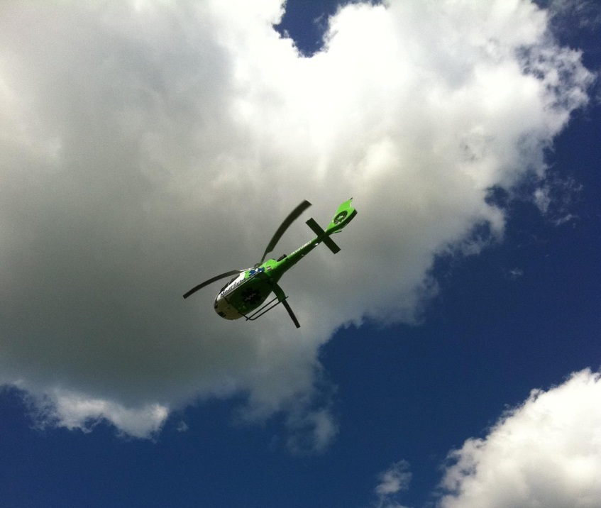
Departure Safety and Security
Direct bystanders and/or
colleagues to a safe distance
Watch for loose debris
Alert pilot of any problems
or concerns
Maintain LZ for several minutes
in case aircraft needs to return
(trauma arrest, “chip light”, etc.)

Slide 54
HAZMAT

Slide 55

Hazardous Materials
FAA prohibits transportation of Hazard Material (no contaminated clothing)
PATIENTS MUST BE DECONTAMINATED PRIOR TO TRANSPORT BY HELICOPTER
Helicopter crews do not have protective gear or breathing apparatus
Any helicopter LZ should be AT LEAST 1 MILE upwind of explosives, poisonous gasses, or chemicals in danger of exploding

Slide 56
HAZMAT Situations
Helicopter engine exhaust can ignite combustible gases.
Rotor wash can blow hazardous material over a large area.
Avoid setting up the LZ in low lying areas near the scene.
Avoid setting up a LZ down wind of an accident site.
Do not put contaminated items on-board the helicopter.
Never assume its not a HAZMAT situation

Slide 57
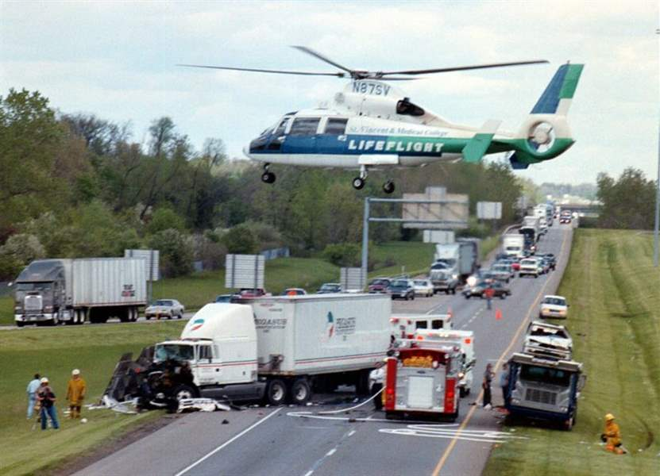
Questions?

